Slide 1


LATEX – WORKSHOP – Day 02
Dr. Jothimurugan Ruthiramoorthy
M.Sc., B. Ed., Ph.D
Assistant Controller of Examinations
Assistant Professor of Physics
PG Department of Physics
GTN Arts College (Autonomous)
Dindigul – 624 005
Email: jothigtn@gmil.com
Jamal Mohammed College, Trichy

Slide 2
LATEX – WORKSHOP – Day 02
What will we learn today?
Mathematical Symbols and Equations
Figures – Captions
Tables – Captions
Bibliography
Jamal Mohammed College, Trichy

Slide 3
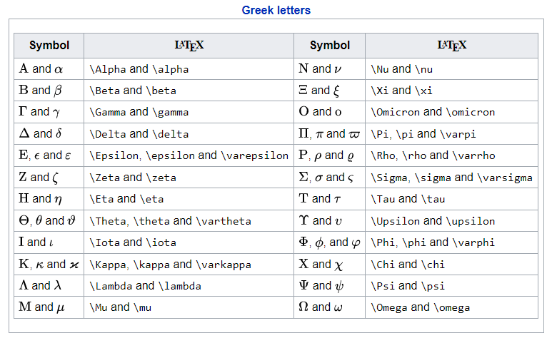
LATEX – WORKSHOP – Day 02
Mathematical Symbols
For more symbols you may refer the
free wiki pages in the links given
below
https://oeis.org/wiki/List_of_LaTeX_mathematical_symbols
Jamal Mohammed College, Trichy

Slide 4
LATEX – WORKSHOP – Day 02
Mathematical Equations
Format - 1
Format - 2
Format - 3
In line equation
\begin{equation}
\begin{eqnarray}
\label{eq:}
\end{eqnarray}
\label{eq:}
\end{equation}
$f(x) = x^2$
Jamal Mohammed College, Trichy

Slide 5
LATEX – WORKSHOP – Day 02
Mathematical Equations - matrix
pmatrix, bmatrix, vmatrix, Vmatrix are Latex environments:
p for parens
b for brackets
V for double verts
v for verts
B for braces
Jamal Mohammed College, Trichy

